Slide 1
Consistency of Replicated Database Part I
CS-212 Distributed Database Systems
Instructor: Ms. Mariam Nosheen
Computer Science Department LCWU, Lhr

Slide 2
Outline
Data Replication
➡ Consistency criteria
Ms. Mariam Nosheen
CS- 212 Distributed Database Systems

Slide 3
Replication
Why replicate?
➡ System availability
✦ Avoid single points of failure
➡ Performance
✦ Localization
➡ Scalability
✦ Scalability in numbers and geographic area
➡ Application requirements
•Why not Replicate?
➡ Replication transparency
➡ Consistency issues
✦ Updates are costly
✦ Availability may suffer if not careful
Ms. Mariam Nosheen
CS- 212 Distributed Database Systems

Slide 4
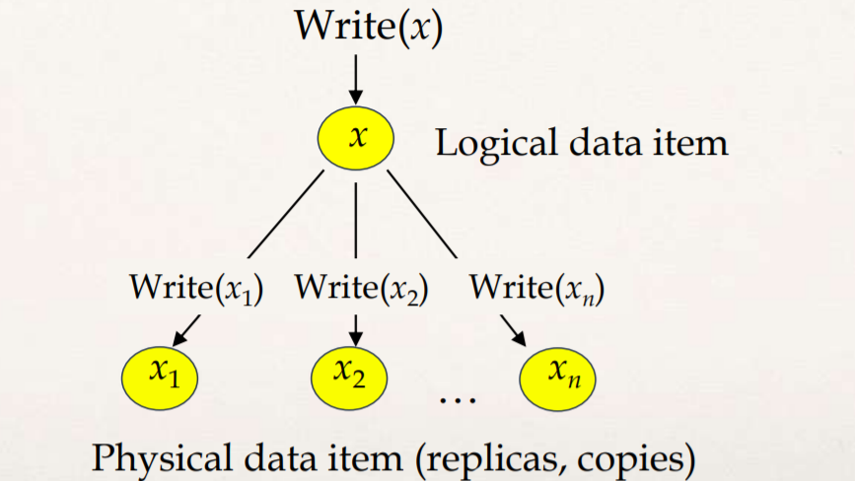
Execution Model
There are physical copies of logical objects in the system.
• Operations are specified on logical objects, but translated to operate on physical objects.
• One-copy equivalence
➡ The effect of transactions performed by clients on replicated objects should be the same as if they had been performed on a single set of objects.
Ms. Mariam Nosheen
CS- 212 Distributed Database Systems

Slide 5
Replication Issues
Consistency models - how do we reason about the consistency of the “global execution state”?
➡ Mutual consistency
➡ Transactional consistency
Where are updates allowed?
➡ Centralized
➡ Distributed
Update propagation techniques – how do we propagate updates to one copy to the other copies?
➡ Eager
➡ Lazy
Ms. Mariam Nosheen
CS- 212 Distributed Database Systems

Slide 6
Consistency
Mutual Consistency
➡ How do we keep the values of physical copies of a logical data item synchronized?
➡ Strong consistency
✦ All copies are updated within the context of the update transaction
✦ When the update transaction completes, all copies have the same value
✦ Typically achieved through 2PC
➡ Weak consistency
✦ Eventual consistency: the copies are not identical when update transaction completes, but they eventually converge to the same value
✦ Many versions possible:
✓ Time-bounds
✓ Value-bounds
✓ Drifts
Ms. Mariam Nosheen
CS- 212 Distributed Database Systems

Slide 7
Transactional Consistency
How can we guarantee that the global execution history over replicated data is serializable?
One-copy serializability (1SR)
➡ The effect of transactions performed by clients on replicated objects should be the same as if they had been performed one at-a-time on a single set of objects.
Weaker forms are possible
➡ Snapshot isolation
➡ RC-serializability
Ms. Mariam Nosheen
CS- 212 Distributed Database Systems

Slide 8
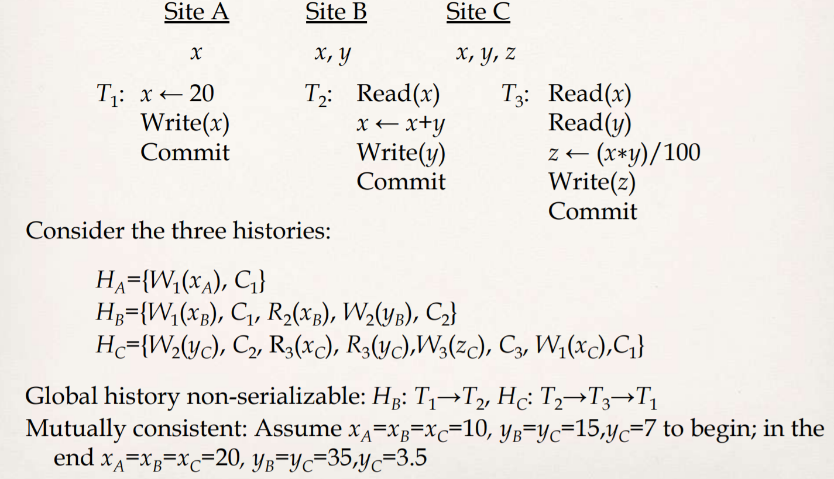
Example 1
Ms. Mariam Nosheen
CS- 212 Distributed Database Systems

Slide 9
Update Management Strategies
Depending on when the updates are propagated
➡ Eager
➡ Lazy
Depending on where the updates can take place
➡ Centralized
➡ Distributed
Ms. Mariam Nosheen
CS- 212 Distributed Database Systems

Slide 10
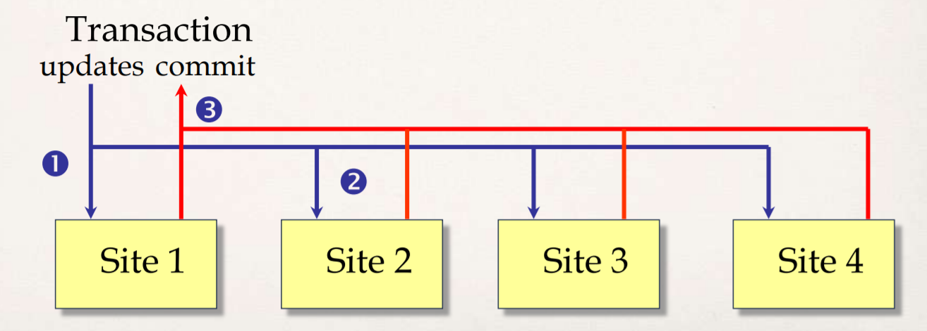
Eager Replication
Changes are propagated within the scope of the transaction making the changes. The ACID properties apply to all copy updates.
➡ Synchronous
➡ Deferred
ROWA protocol: Read-one/Write-all
Ms. Mariam Nosheen
CS- 212 Distributed Database Systems

Slide 11
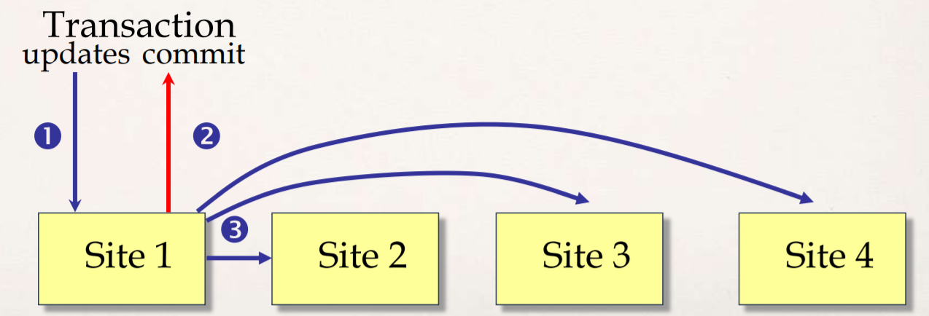
Lazy Replication
Lazy replication first executes the updating transaction on one copy. After the transaction commits, the changes are propagated to all other copies (refresh transactions)
While the propagation takes place, the copies are mutually inconsistent.
The time the copies are mutually inconsistent is an adjustable parameter which is application dependent. Site 1 Site 2 Site 3 Site 4 Transaction
Ms. Mariam Nosheen
CS- 212 Distributed Database Systems

Slide 12
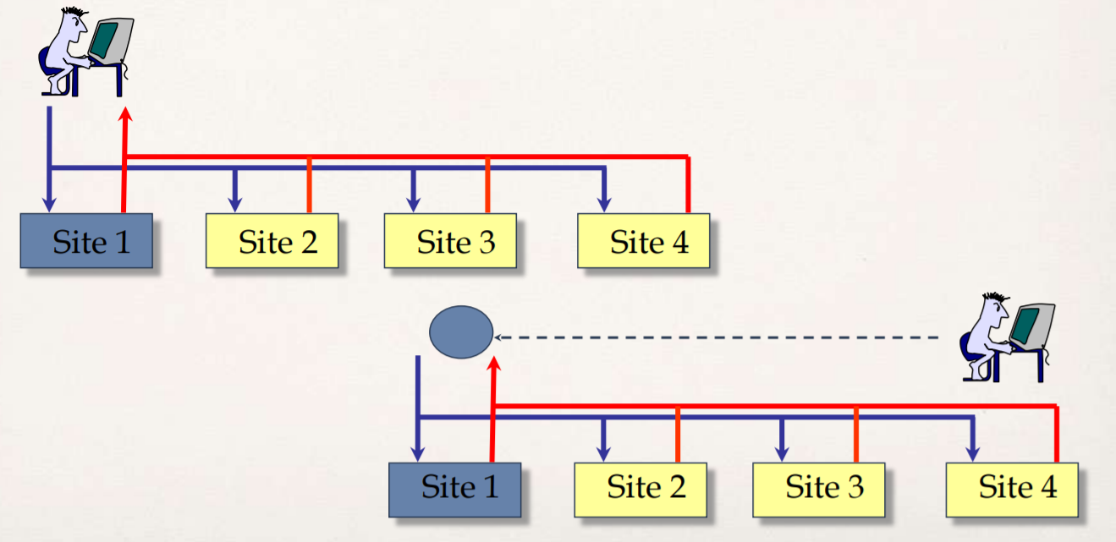
Centralized
There is only one copy which can be updated (the master), all others (slave copies) are updated reflecting the changes to the master.
Ms. Mariam Nosheen
CS- 212 Distributed Database Systems

Slide 13
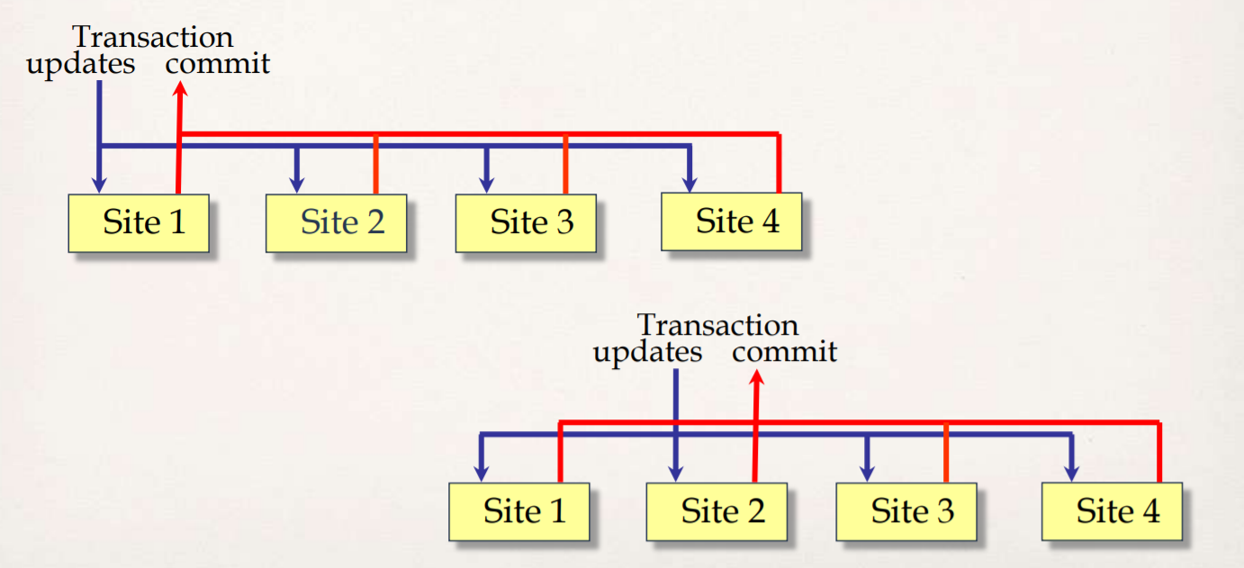
Distributed
Changes can be initiated at any of the copies. That is, any of the sites which owns a copy can update the value of the data item.
Ms. Mariam Nosheen
CS- 212 Distributed Database Systems

